Slide 1

DevOps: The Idea OF Continuous Delivery

Slide 2
What challenges are associated with a traditional application lifecycle?
The traditional application lifecycle tends to separate developing software from the process of operationalizing it, which involves delivering it to its intended recipients and ensuring that it functions in the optimal manner. This siloed approach leads to many inefficiencies.
For one, developers and operational teams have commonly different objectives. The former focuses on innovation and continuous enhancements to its software. The primary objective of the latter is to maintain the stability and security of the environment they support.
In addition, traditional operational practices are frequently based on an outdated, largely manual approach, which is inherently slow and vulnerable to human errors. This impedes the pace of innovation and increases the level of risk associated with the deployment of new or updated versions of applications.

Slide 3
What is DevOps:
DevOps is a software development methodology that accelerates the delivery of high-performance applications and services by combining and automating the work of software development (Dev) and IT operations (Ops) teams. [IBM]
DevOps is a concept that aims to address the challenges associated with traditional application lifecycle. [Microsoft]
"DevOps is the union of people, process, and products to enable continuous delivery of value to our end users." - Donovan Brown
DevOps is a set of principles, practices, and values that are meant to enhance cross-team synergies, with the common goal of optimizing software delivery. [Microsoft]
The hallmarks of DevOps are continuous integration and continuous delivery (CI/CD), which support smaller, faster software updates. With CI/CD, small chunks of new code are merged into the code base at frequent intervals, and then automatically integrated, tested, and prepared for deployment to the production environment.

Slide 4
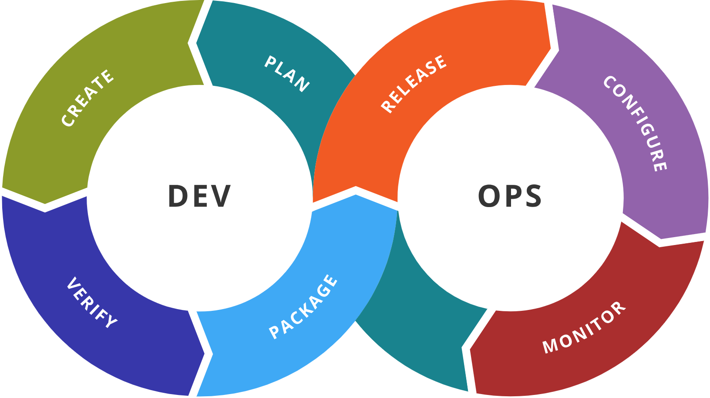
What is DevOps:

Slide 5
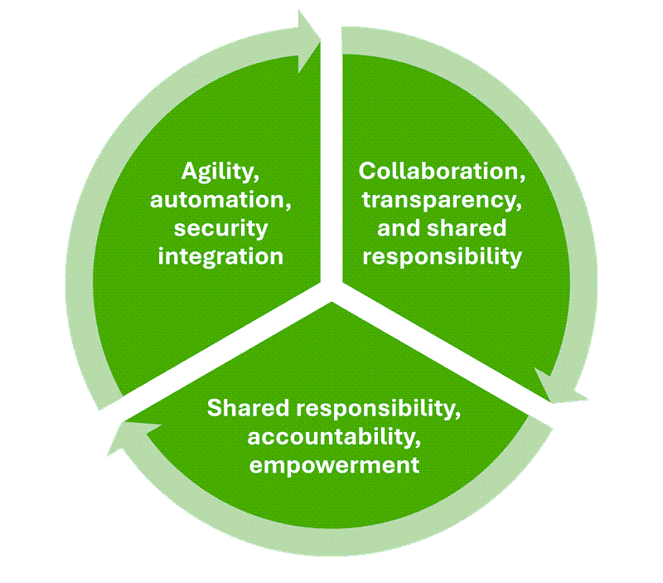
What are the key elements of DevOps culture?

Slide 6
DevOps goals and benefits:
Accelerating time to market
Adapting to market dynamics and competition
Sustaining stability and reliability in operations
Minimizing the mean time to recovery (MTTR)
It's important to note that DevOps benefits extend beyond the lifecycle of traditional applications. Its scope includes, for example, such areas as machine learning (with operations applied to implementing machine learning models) and infrastructure (with Infrastructure as Code applied to deployment of underlying platform services).

Slide 7
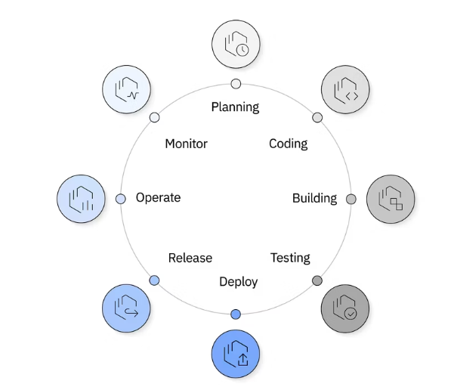
DevOps Lifecycle:
The DevOps lifecycle is designed to optimize the rapid delivery of high-quality software. It includes a series of iterative, automated workflows that run within a larger automated and iterative development lifecycle.

Slide 8
DevOps Lifecycle:
Building. New code is integrated into the existing code base, then tested and packaged for release and deployment. Activities that are often automated at this stage include merging code changes into a master copy; placing the updated code into a repository; and compiling, testing, and packaging code into an executable file. In DevOps, the output of the build phase is often stored in a binary repository. Unlike a source code repository, a binary repository stores packaged outputs, such as libraries and executable files, to be reused in other phases of the development lifecycle.
Deploy. At this stage, the project moves to a production environment where users can access the updated application. Many organizations deploy first to a subset of end users to ensure that the application works properly. When stability is established, the application can be deployed to everyone.
Operate. In this stage, DevOps teams check that new features are running smoothly and are available to users with no interruptions in service. They use automated observability and management tools to continuously monitor and optimize operations to make sure that network, storage, platform, compute and security postures are all working properly.
Monitor. At this stage, teams collect and analyze feedback from users and lessons from previous workflows to inform improvements in processes and products moving forward. This continuous monitoring of features, functions, performance, and business value informs the planning for the next release of new features and enhancements.

Slide 9
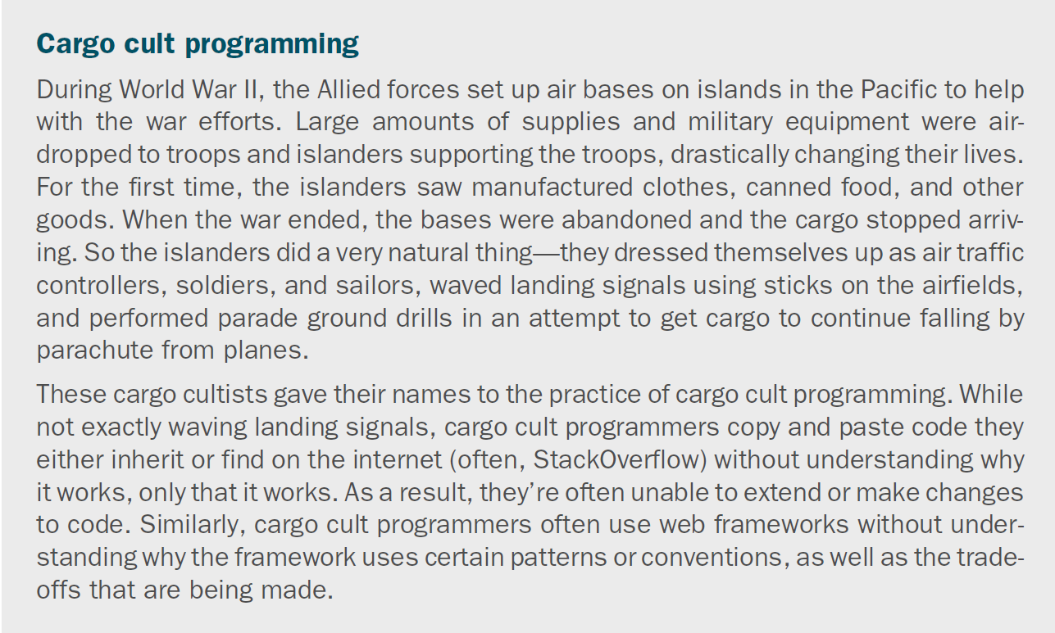

Slide 10
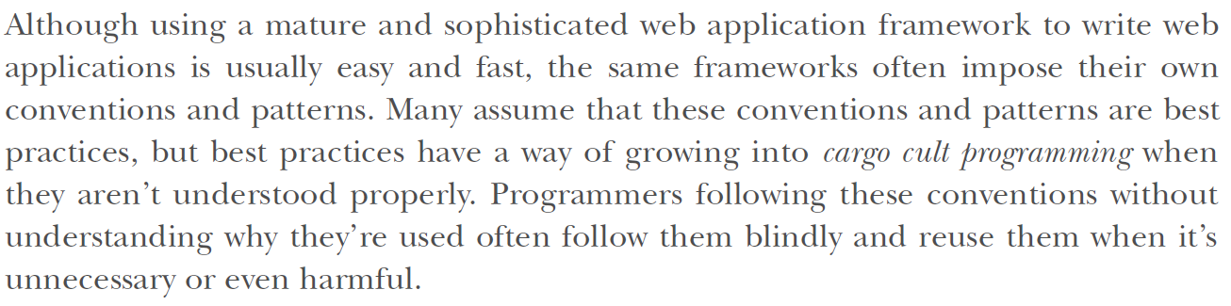

Slide 11
CI/CD:
Software development is moving fast, and every engineering team says they are shipping 10x faster with the help of AI. With speed, it is important to maintain the quality of software and ensure no inconsistencies or bugs are slipping through.
There are these bugs in production that happen because something wasn’t tested, merged incorrectly, or pushed a little too confidently on a Friday evening. It ended up allowing the software to be pushed out despite containing problematic content data.
CI/CD stands for Continuous Integration and Continuous Delivery/Deployment. but at its core, it’s just about making sure code changes are merged, tested, and delivered in a way that doesn’t make developers (or users) panic.
Continuous Integration (CI) is the habit of automatically checking and merging code changes into a shared repo. So instead of everyone working in silos and hoping things don’t break when merged, every push triggers a set of actions: tests run, linters catch sloppy code, and issues are flagged early.
Continuous Delivery (CD) takes that validated code and gets it ready for release, automatically.
It doesn’t push it to production without human approval, but it makes sure that when you're ready to ship, everything is packaged, tested, and waiting.

Slide 12
CI/CD Pipelines:
The continuous integration/continuous delivery (CI/CD) pipeline is an automated DevOps workflow that streamlines the software delivery process.
A vital characteristic of the CI/CD pipeline is the use of automation to help ensure code quality. As the software changes progress through the pipeline, automated tests identify dependencies and other issues earlier, push code changes to different environments and deliver applications to production environments.
Test
Deliver
Deploy
Build

Slide 13
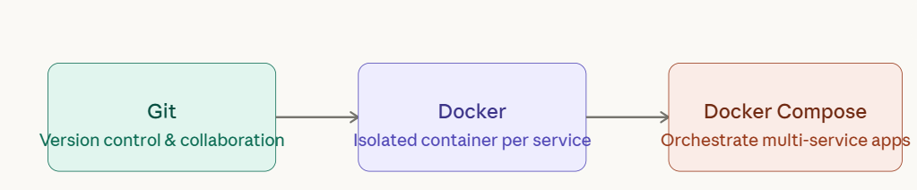
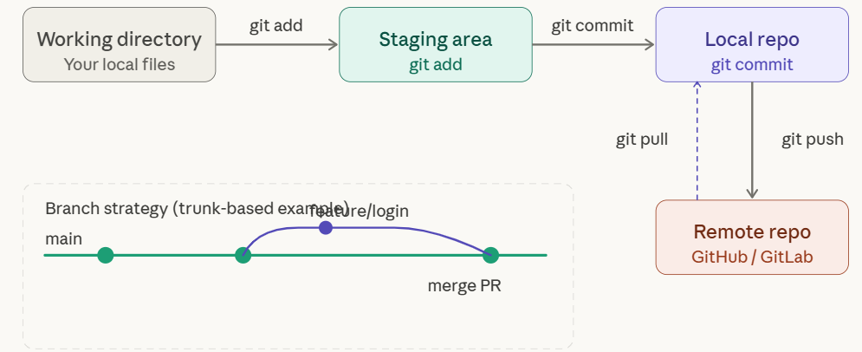
Building Our CI/CD pipeline:
Every DevOps workflow starts with source control. Git lets your whole team work on the same codebase without stepping on each other — and it gives you a full history so you can always roll back.

Slide 14
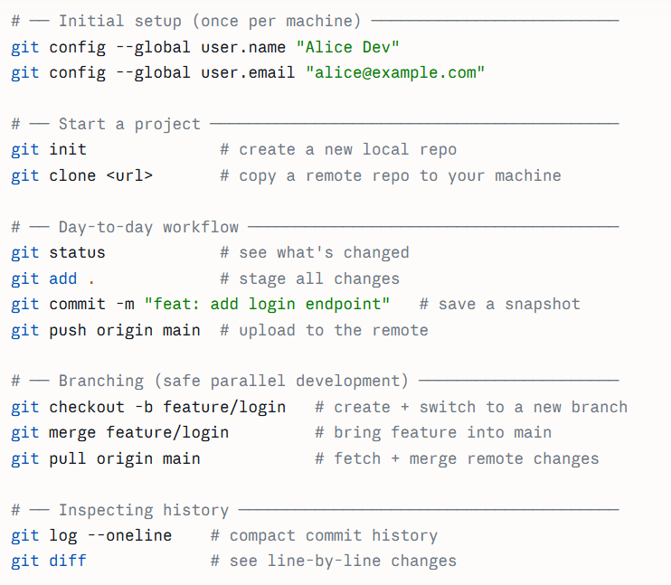
Building Our CI/CD pipeline:
Every DevOps workflow starts with source control. Git lets your whole team work on the same codebase without stepping on each other — and it gives you a full history so you can always roll back.

Slide 15
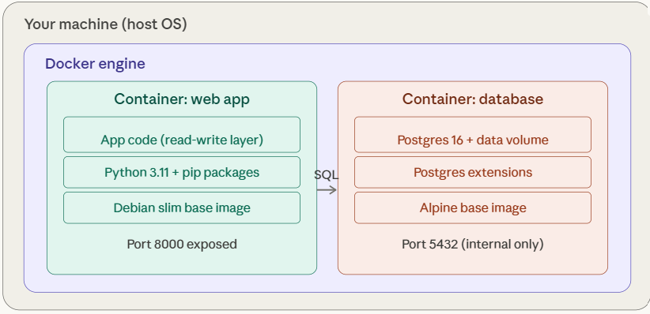
Building Our CI/CD pipeline:
Docker wraps your app and all its dependencies — runtime, libraries, OS packages — into a single portable unit called an image. When you run an image, you get a container: an isolated process with its own filesystem, networking, and process space.

Slide 16
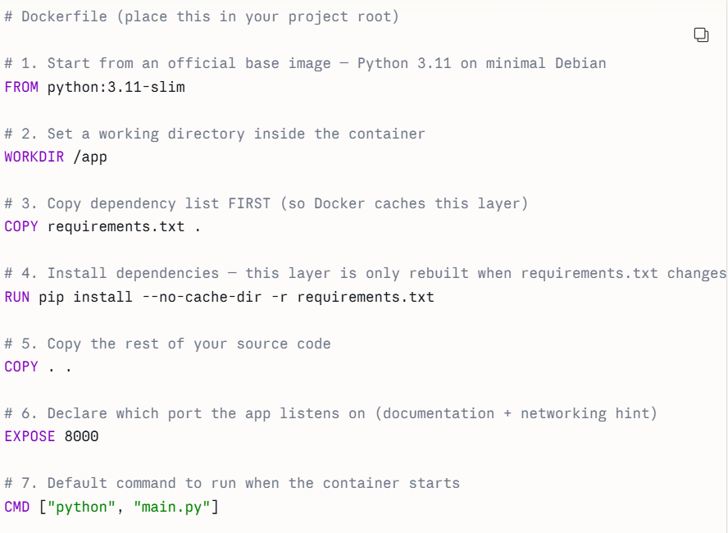
Building Our CI/CD pipeline:
Docker wraps your app and all its dependencies — runtime, libraries, OS packages — into a single portable unit called an image. When you run an image, you get a container: an isolated process with its own filesystem, networking, and process space.

Slide 17
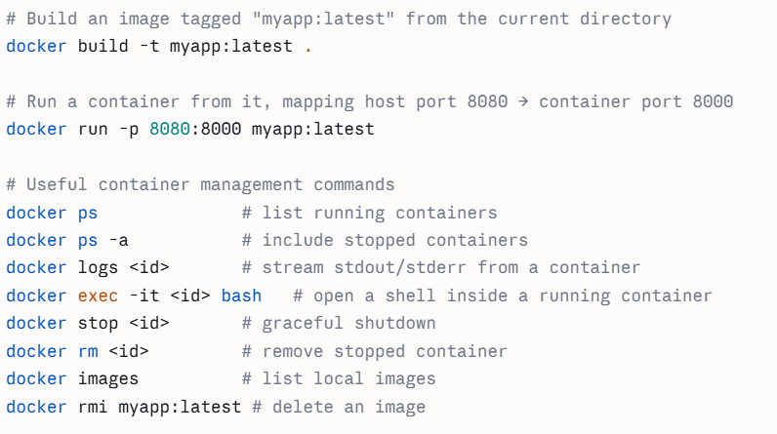
Building Our CI/CD pipeline:
Docker wraps your app and all its dependencies — runtime, libraries, OS packages — into a single portable unit called an image. When you run an image, you get a container: an isolated process with its own filesystem, networking, and process space.

Slide 18
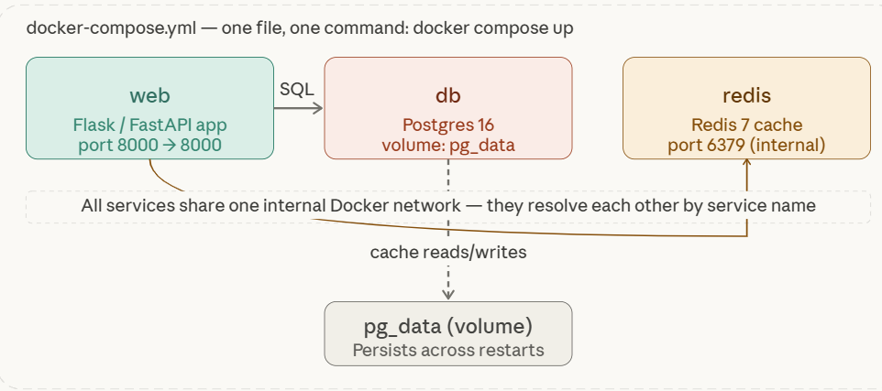
Building Our CI/CD pipeline:
Real apps have multiple services — a web server, a database, a cache, and a background worker. Running and connecting them manually with Docker run is painful. Docker Compose lets you define the entire environment in one YAML file and bring it all up with a single command.

Slide 19
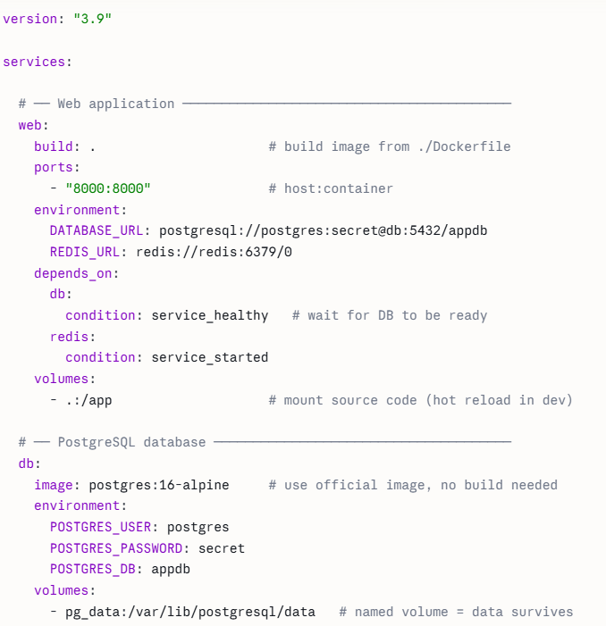
Building Our CI/CD pipeline:
Real apps have multiple services — a web server, a database, a cache, and a background worker. Running and connecting them manually with Docker run is painful. Docker Compose lets you define the entire environment in one YAML file and bring it all up with a single command.

Slide 20
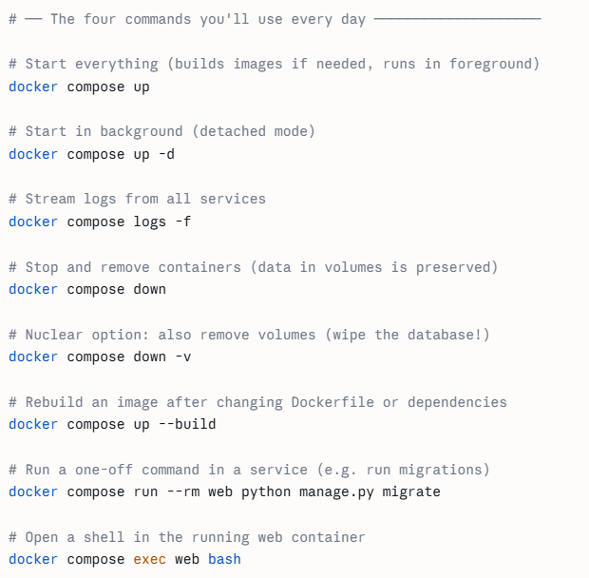
Building Our CI/CD pipeline:
Real apps have multiple services — a web server, a database, a cache, and a background worker. Running and connecting them manually with Docker run is painful. Docker Compose lets you define the entire environment in one YAML file and bring it all up with a single command.

Slide 21
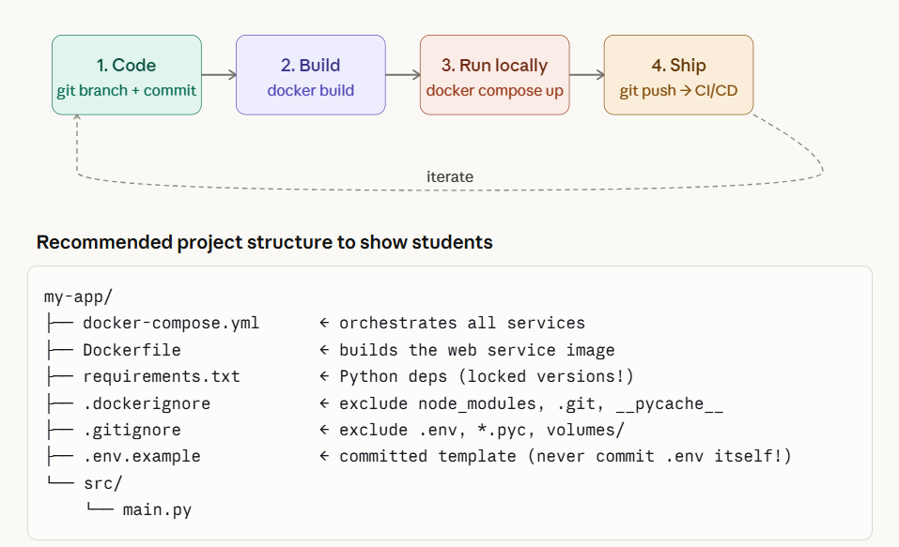
Building Our CI/CD pipeline:

Slide 22
References:
https://learn.microsoft.com/en-gb/training/paths/devops-foundations-core-principles-practices/
https://www.ibm.com/think/topics/devops
https://www.ibm.com/think/topics/ci-cd-pipeline
https://pieces.app/blog/best-ci-cd-tools VERY IMPORTANT!!!!
https://learn.microsoft.com/en-us/training/modules/introduction-to-devops/

Slide 23
THANK YOU

